Slide 1
Combustion reactions

Slide 2
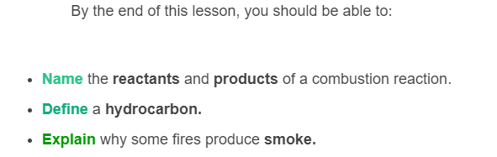
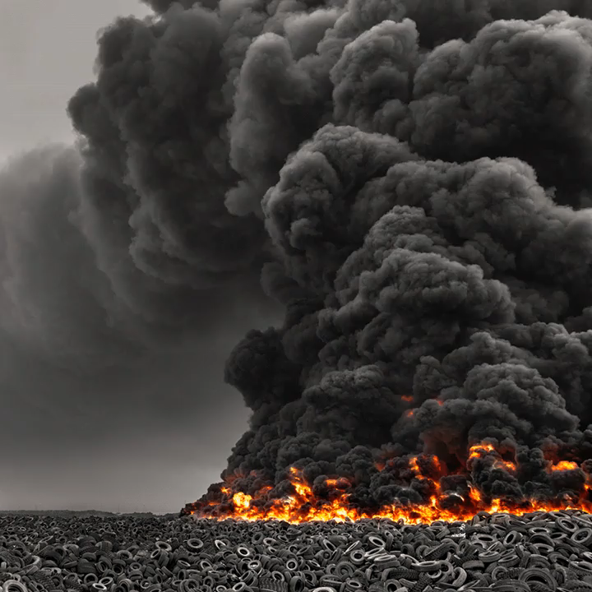

Slide 3
Combustion is an exothermic reaction
A large amount of energy is released as heat by a combustion reaction.
Normally the energy released by combustion will create a fire, but if the reaction happens very quickly then it can also create an explosion.

Slide 4

We can define combustion as a reaction with oxygen.
The other reactant is called the fuel. Many objects can be fuels, with some common fuels being substances like wood, oil and gas.
If there is no oxygen present, a combustion reaction cannot happen - this is why a fire can be stopped by covering it.
Many combustion reactions look like this:
Fuel + Oxygen → Carbon Dioxide + Water

Slide 5
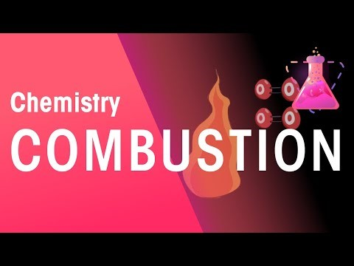

Slide 6
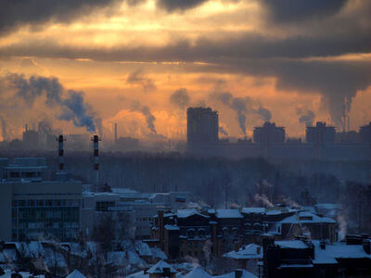
Hydrocarbons are a type of compound which combust extremely well.
Coal, petrol, natural gas and diesel are all examples of hydrocarbons which undergo combustion to produce energy for power plants, fires and cars.

Slide 7

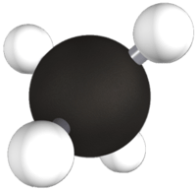
Let's look at a simple example.
The simplest hydrocarbon, methane gas (CH_{4​}), undergoes a combustion reaction in a Bunsen burner:

Slide 8
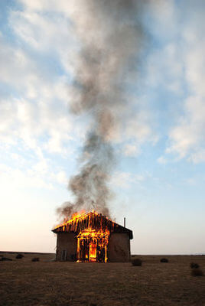
If not enough oxygen is available for combustion, different reactions also happen because in some places there won't be enough oxygen to make the usual products.
These are called "incomplete" reactions. Reactions which happen normally are called "complete."

Slide 9
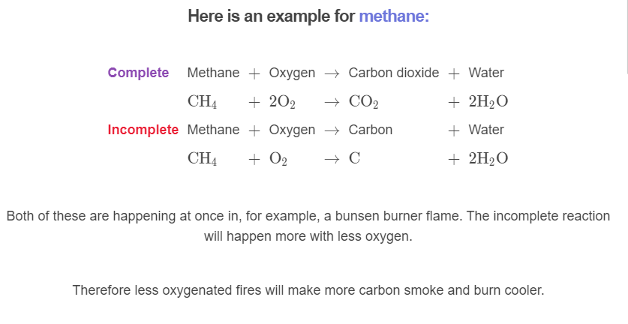

Slide 10
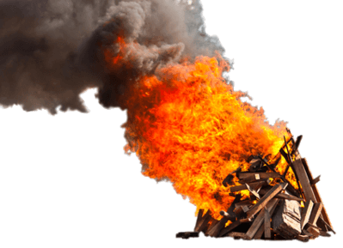
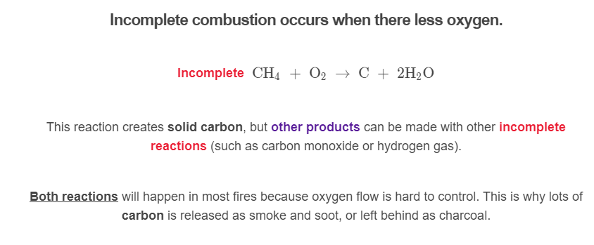

Slide 11
